Slide 1
SDU Summer School - Medical Robotics
Team Potato Pokers
Christian W. Bundschu, Julia Rey Vilches, Jaeseung Byun, Daniel Schober

Slide 2
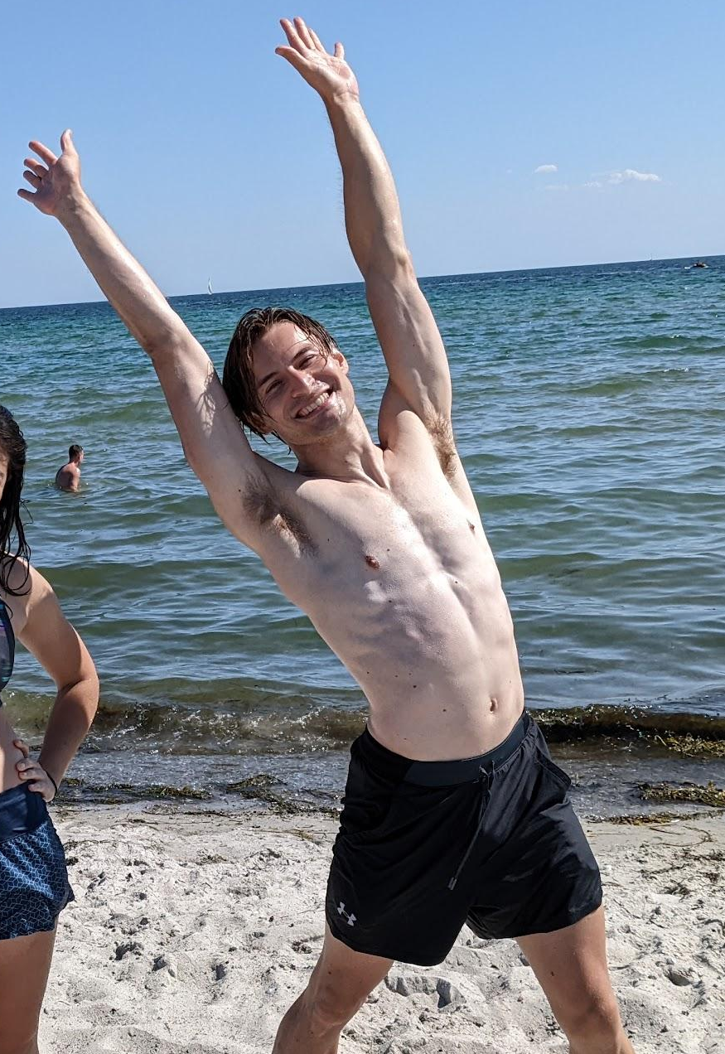
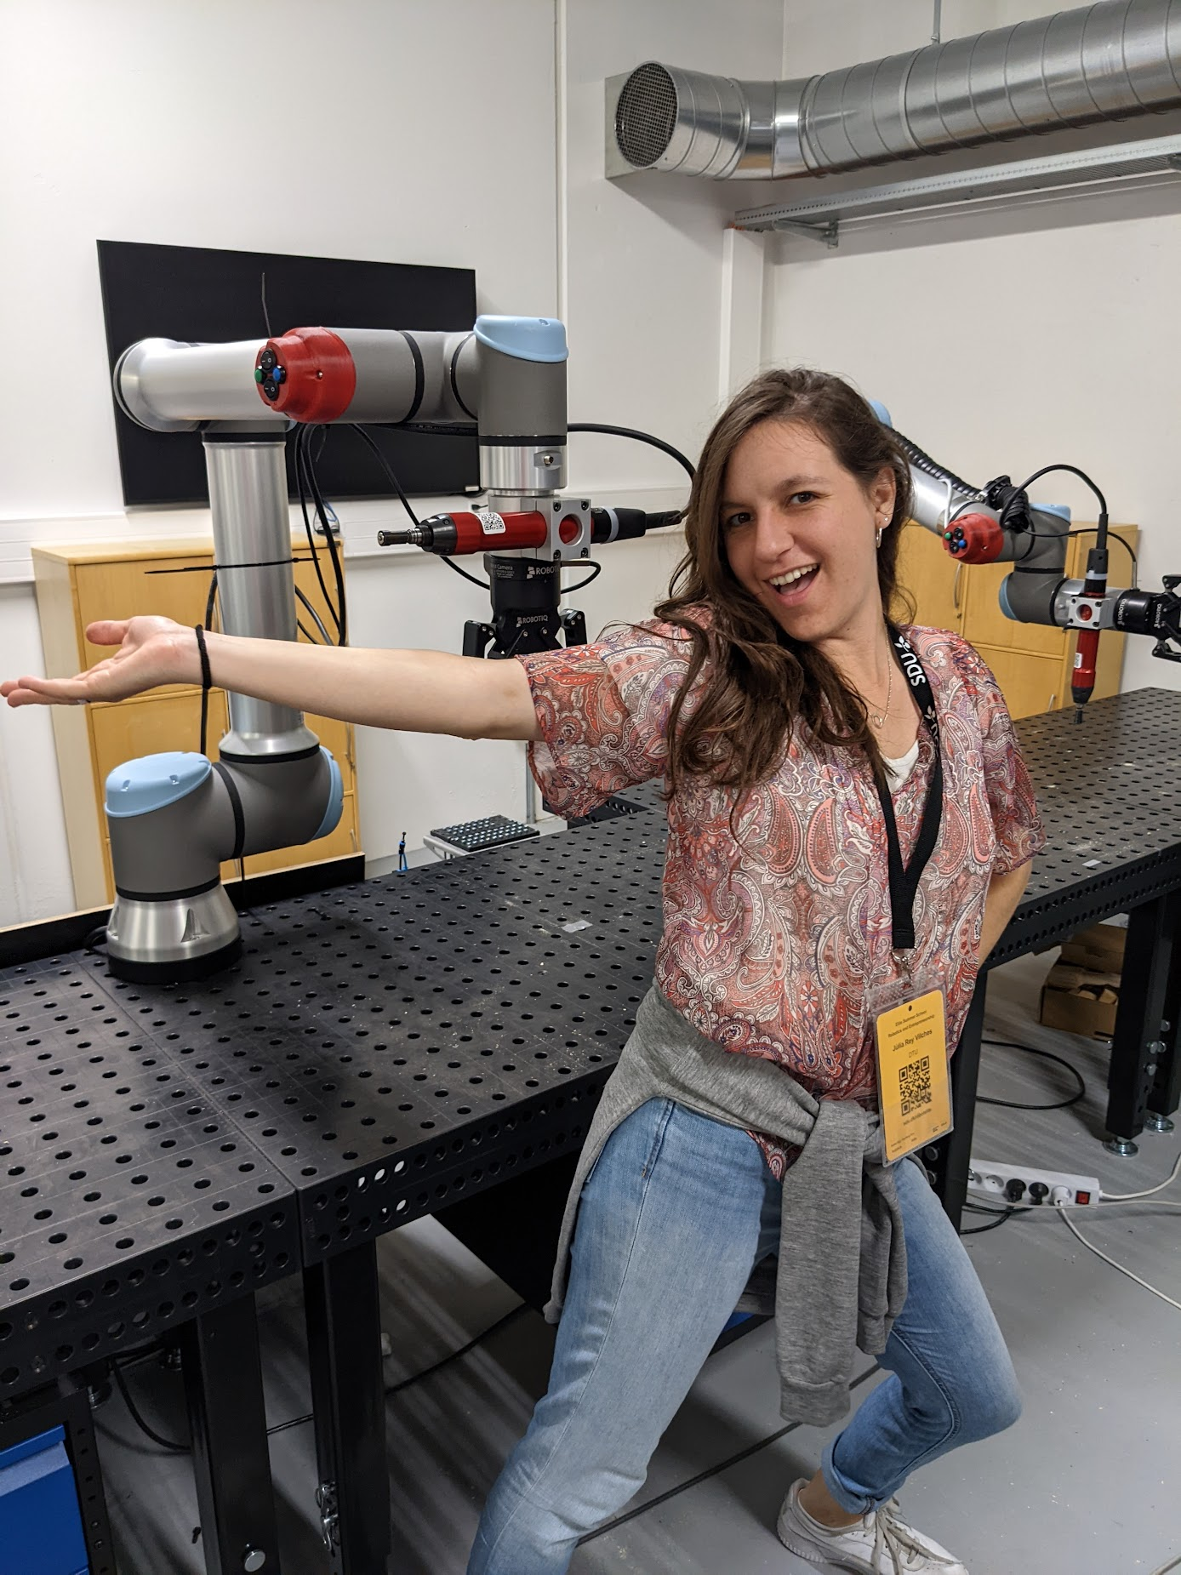

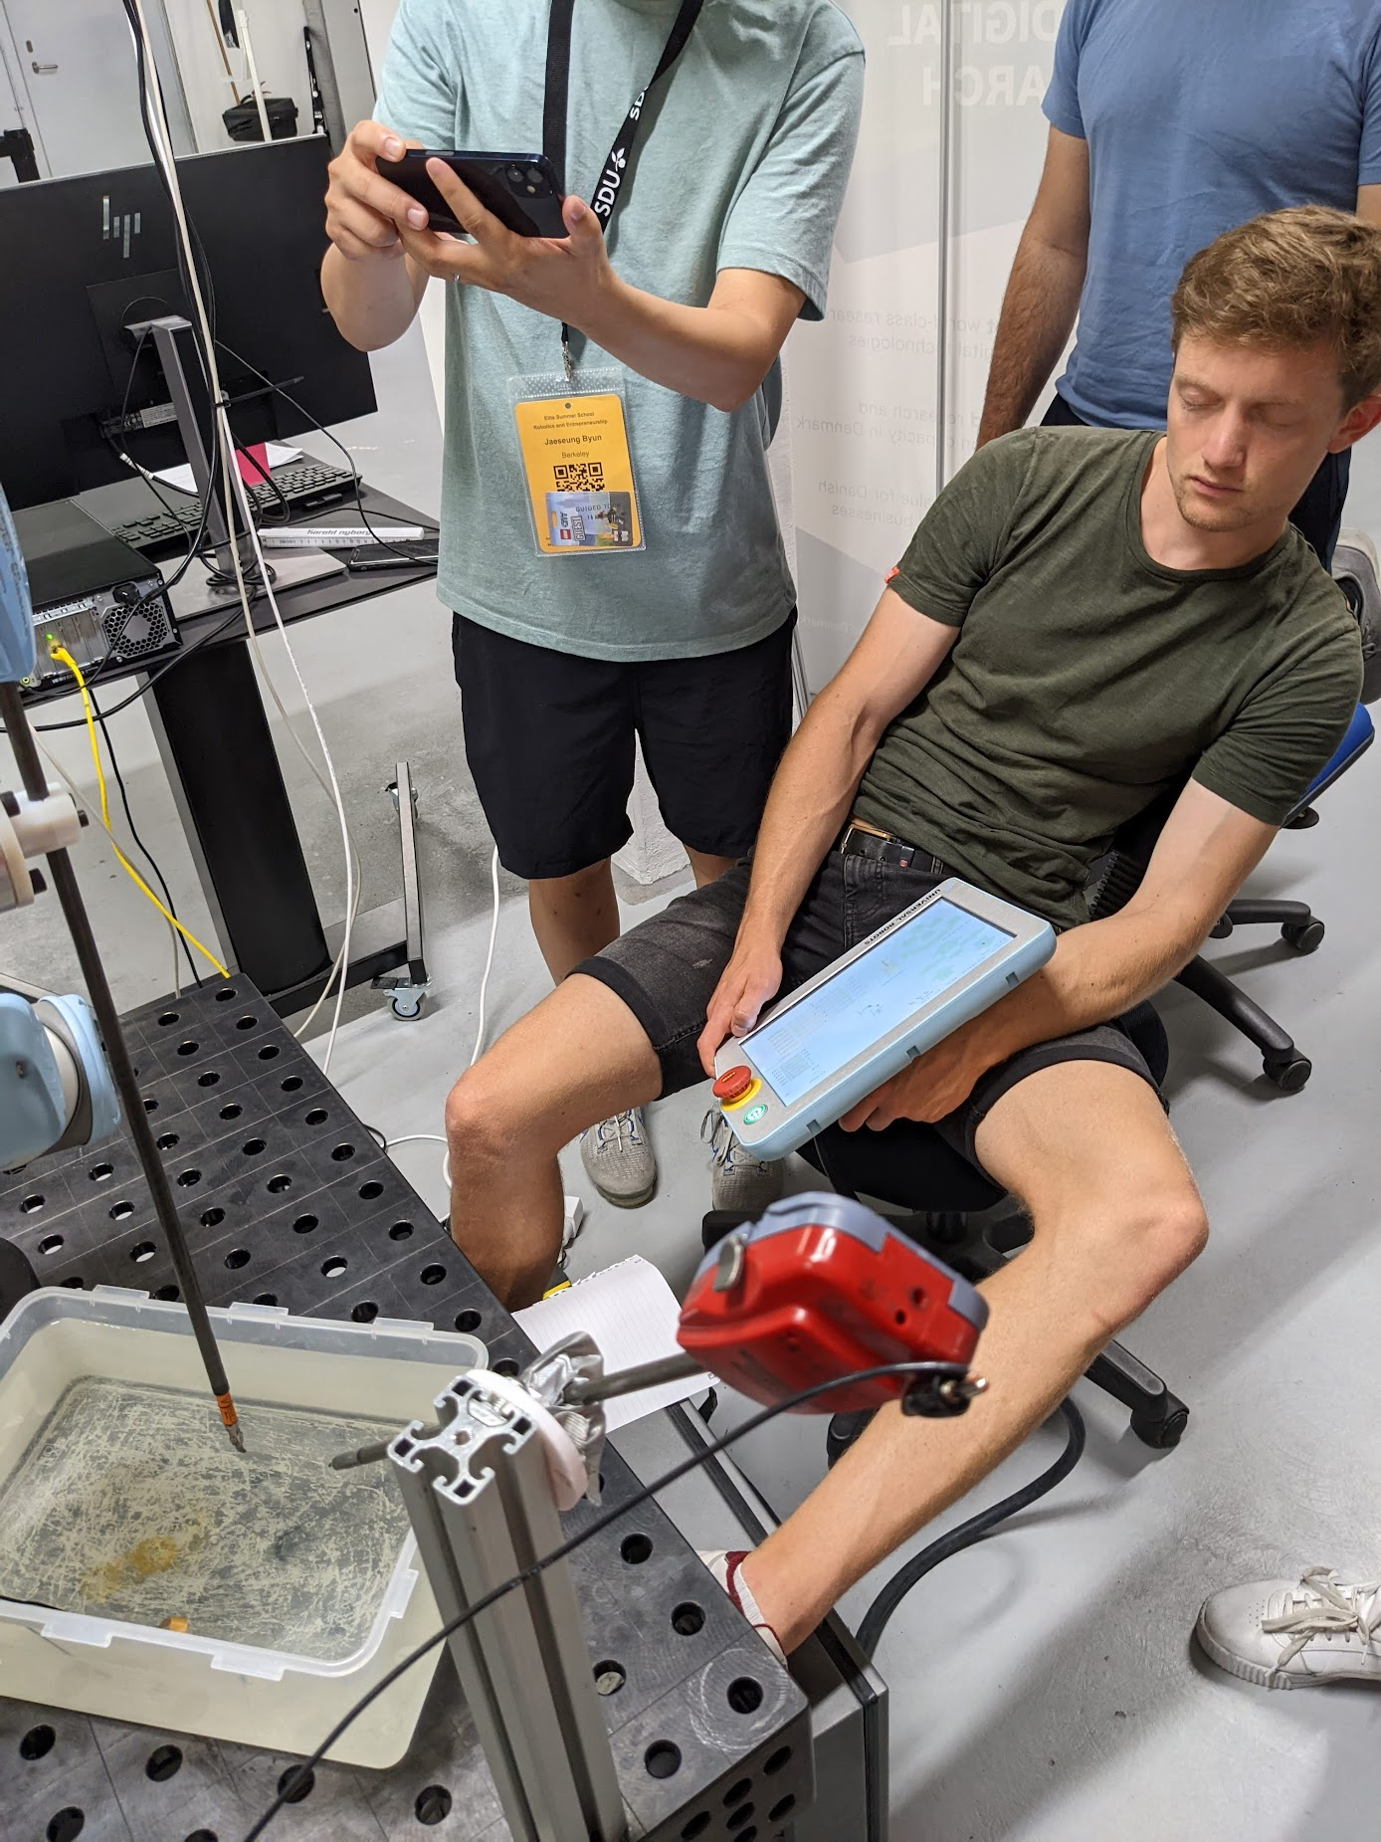
Introduction
Team Members
Christian Bundschu Ph.D. Candidate - Mechanical Engineering
Julia Rey Vilches M.S. Student - Autonomous Systems
Jaeseung Byun Ph.D. Candidate - Mechanical Engineering
Daniel Schober M.S. Student – Autonomous Systems

Slide 3
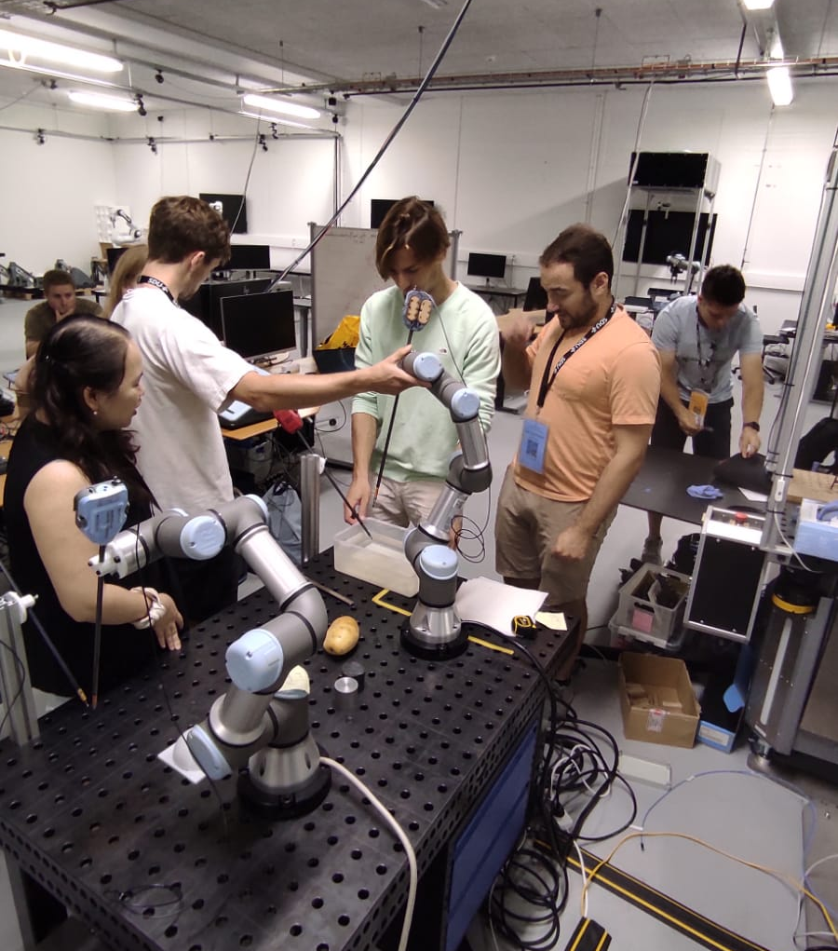
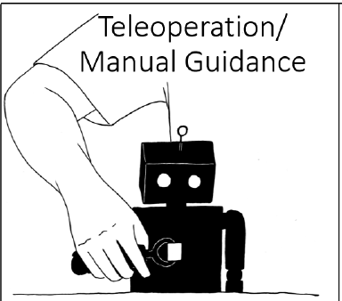
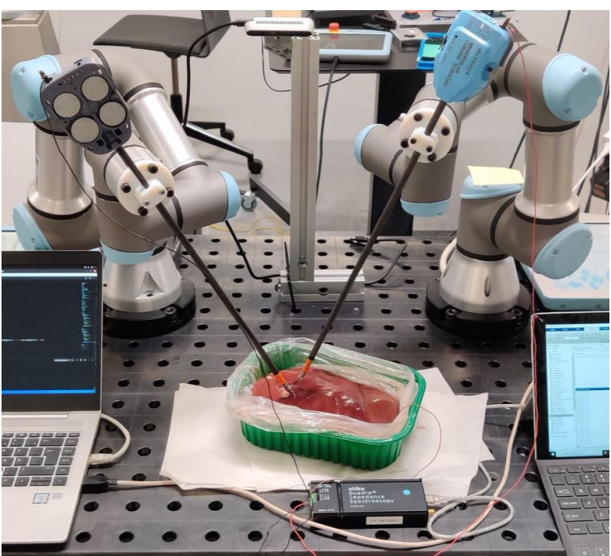
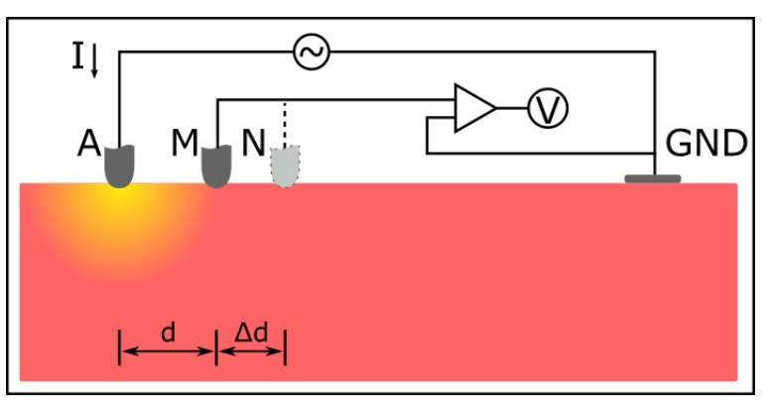
Objectives
Experiment Targets
Teach a robot arm to perform an electrical impedance measurement procedure autonomously:
Using robot learning by demonstration
Conductivity mapping
Encode the learned trajectory using dynamic movement primitives
Generalized for multiple probing locations
Object detection in a pool of ionized water (salted) using electrical impedance detection for the following:
No object
Conductive object
Non-conductive object
Explore the potential for object mapping via experimental procedure

Slide 4
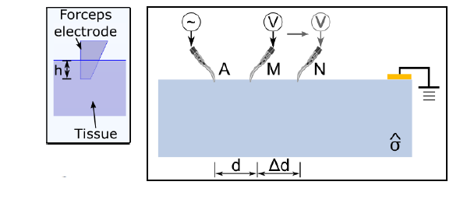
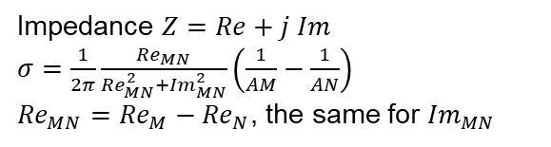
Principles
Object Detection via Conductivity
Tripolar configuration
Impedance $Z=Re+j Im$
$σ=\frac{1}{2π}\frac{{Re}_{MN}}{{Re}_{MN}^{2}+{Im}_{MN}^{2}}\left(\frac{1}{AM}−\frac{1}{AN}\right)$
${Re}_{MN}={Re}_{M}−{Re}_{N}$, the same for ${Im}_{MN}$
Target Object

Slide 5
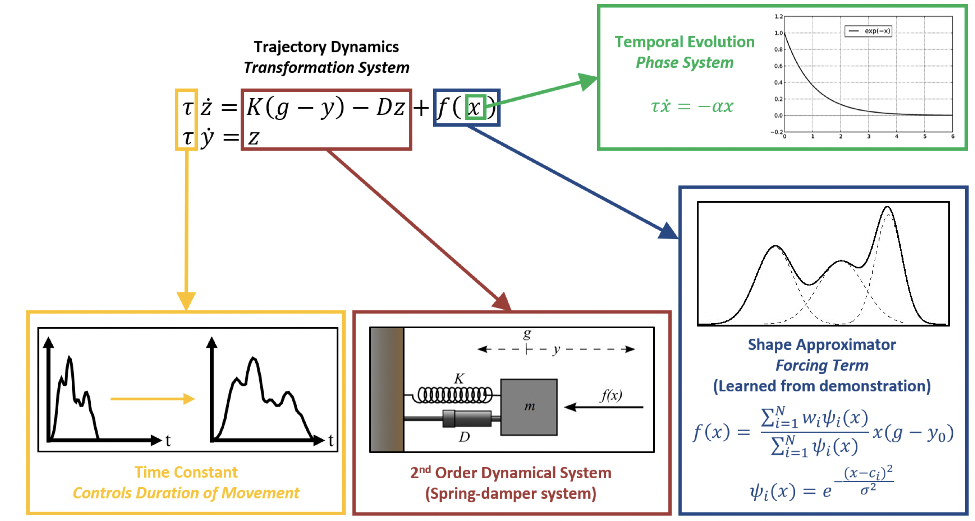
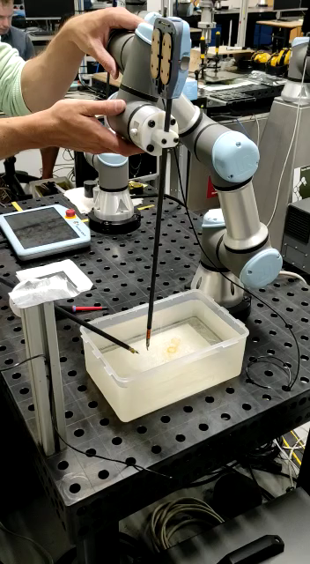
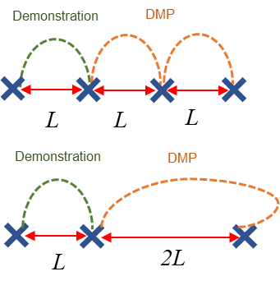
Principles
Learning by demonstration (Manual Guidance)
Dynamic Movement Primitives
Second-order system forced upon by a disturbance term onto a trajectory
Learn the weights of the force function via Gaussian basis functions
One-shot learning
We only have to show the movement to the robot once
We can use different initial and goal points
We can scale the speed of the motion using Tau
Assumptions
Fixed constants of alpha and beta are being used, assuming the M C K of the second order system remain constant (critically damped)
Uniformly spaced distances
Explore the potential for object mapping via experimental procedure
Demonstration
DMP
L
L
L
Demonstration
DMP
L
2L

Slide 6
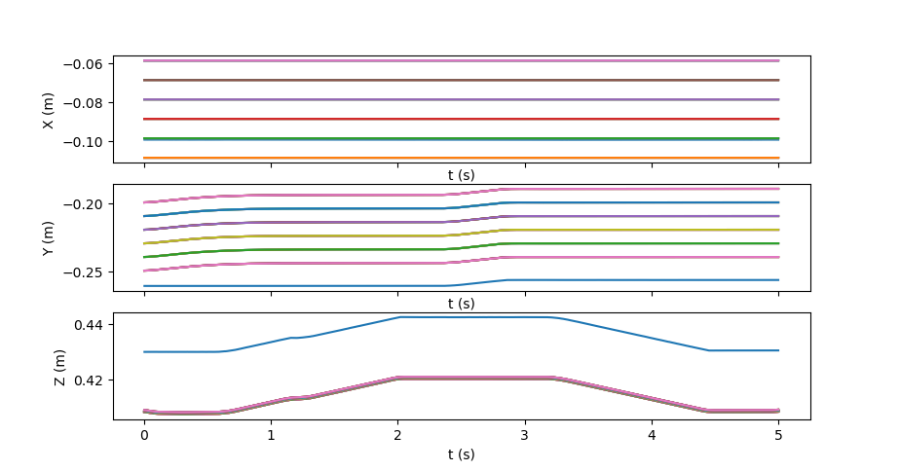
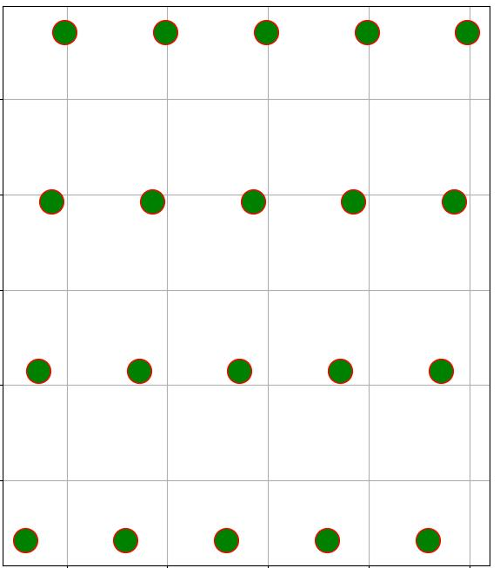
Principles
Trajectory map
DMP Result
Demonstration
DMP
L
L
L
Demonstration
DMP
L
2L
10 mm

Slide 7
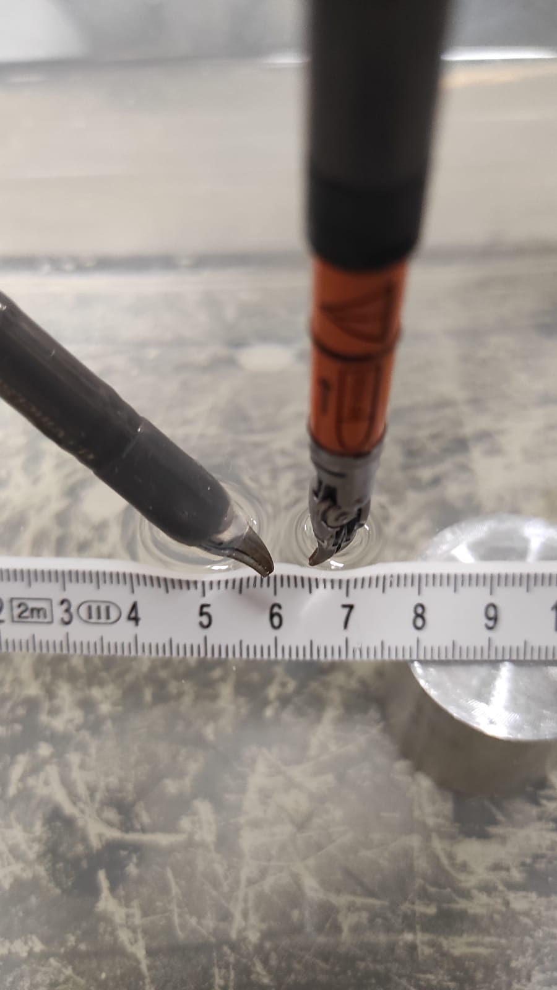
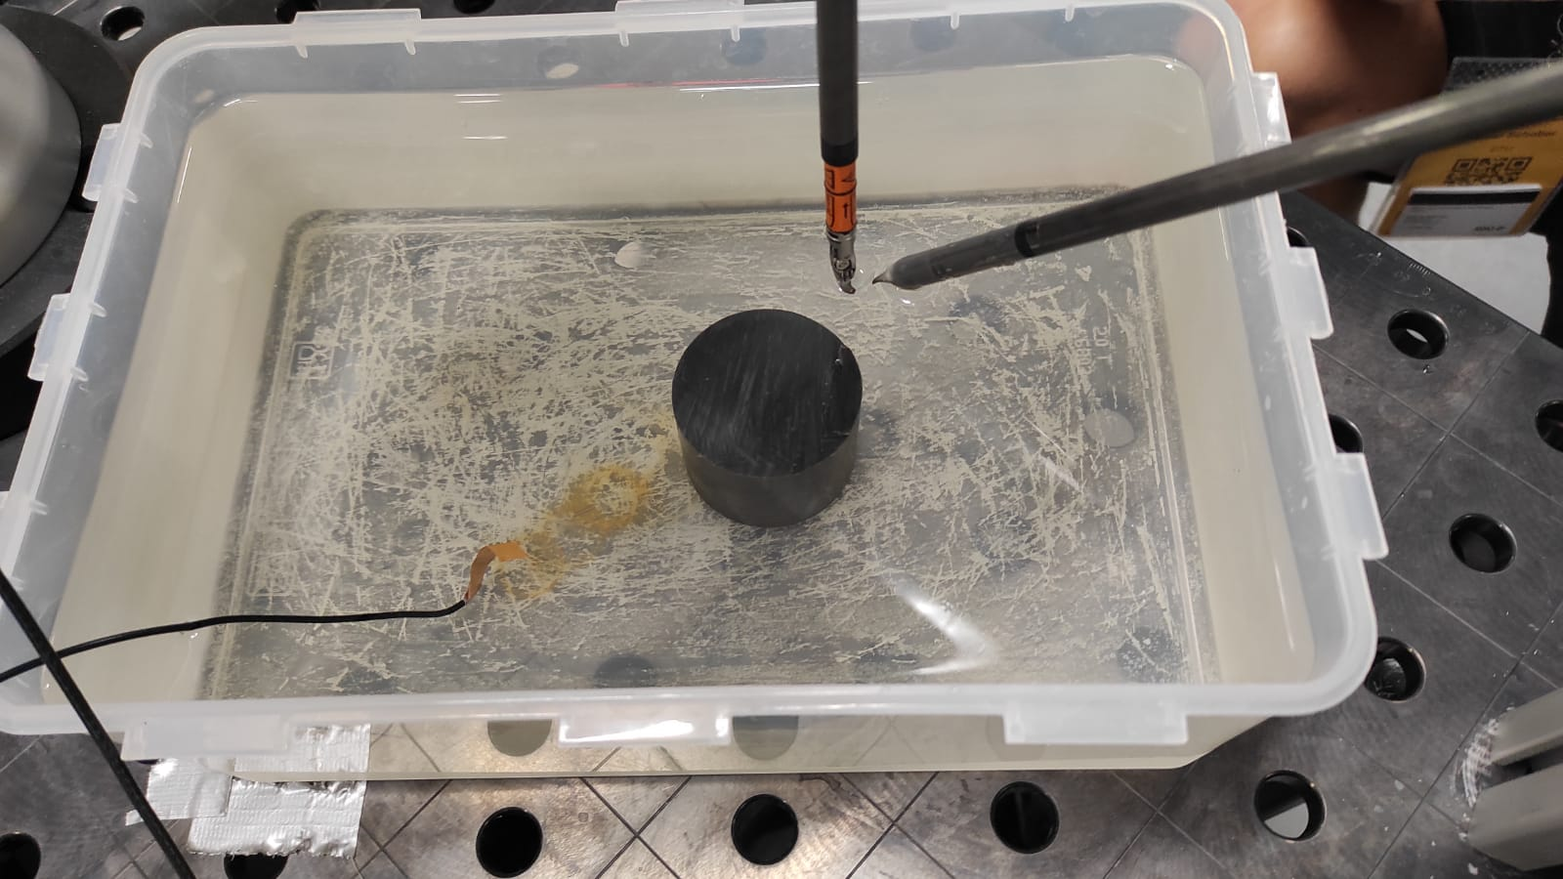
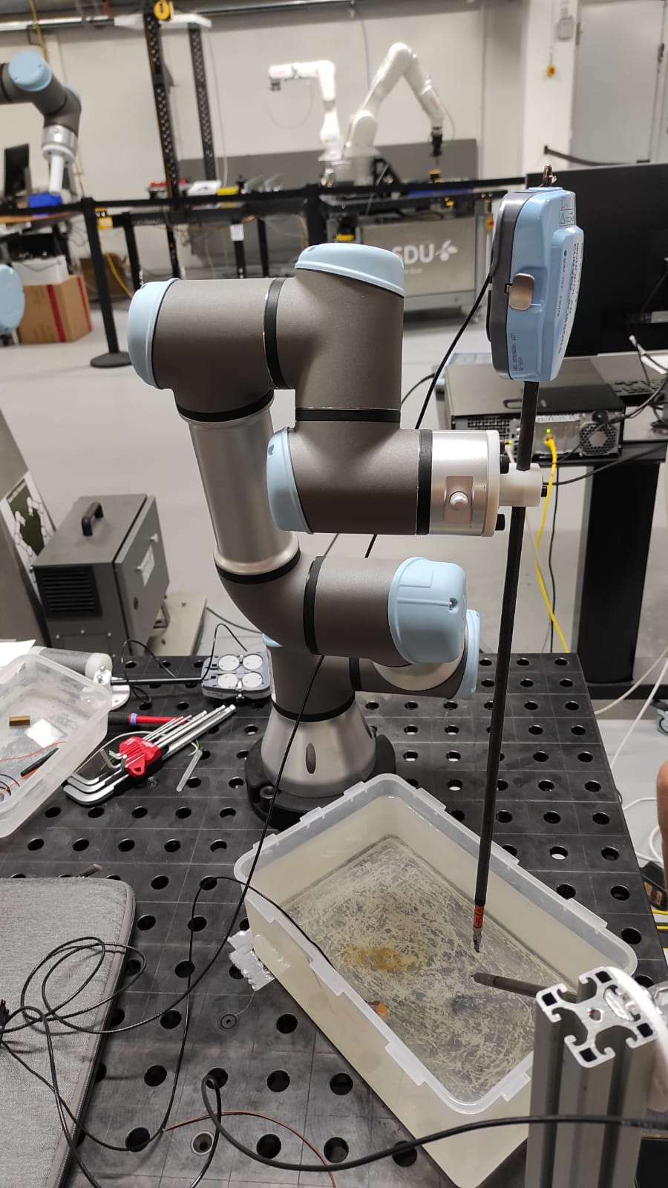
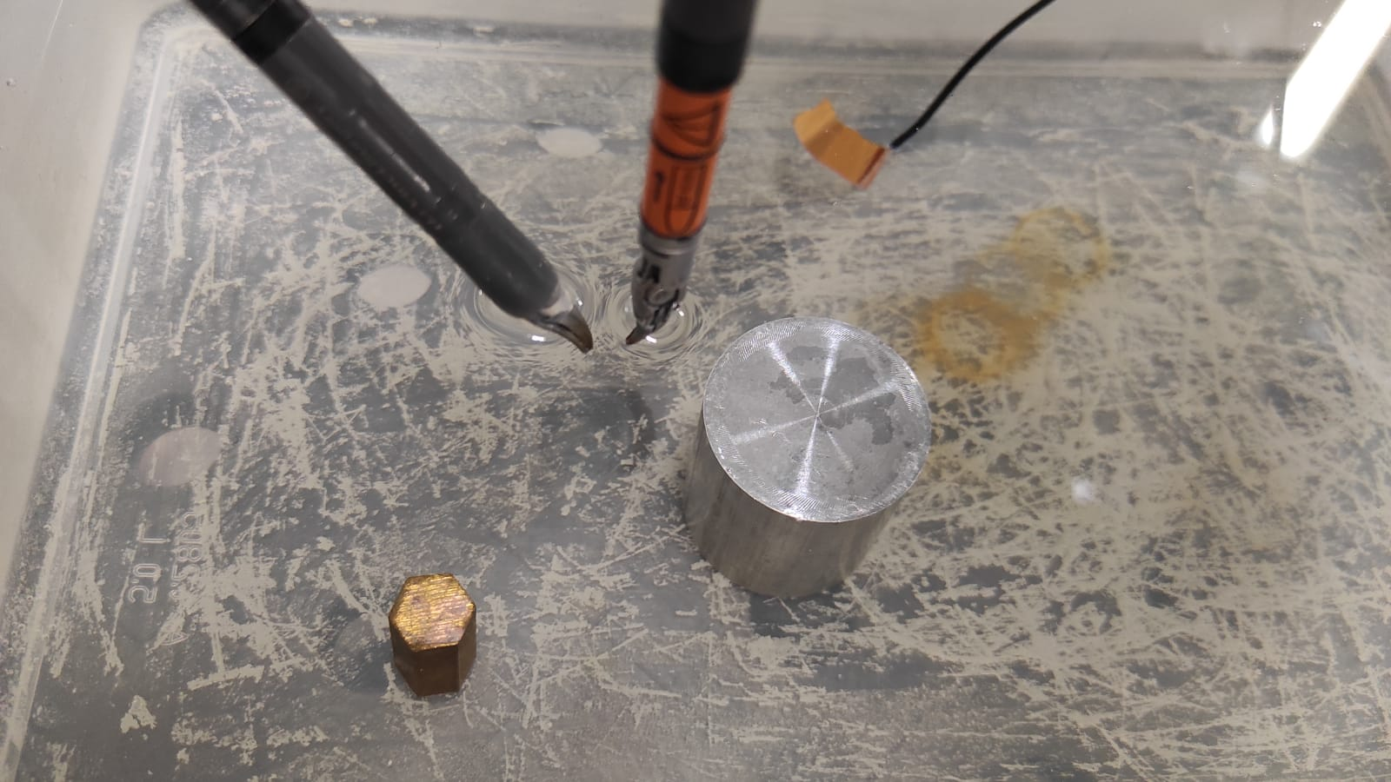
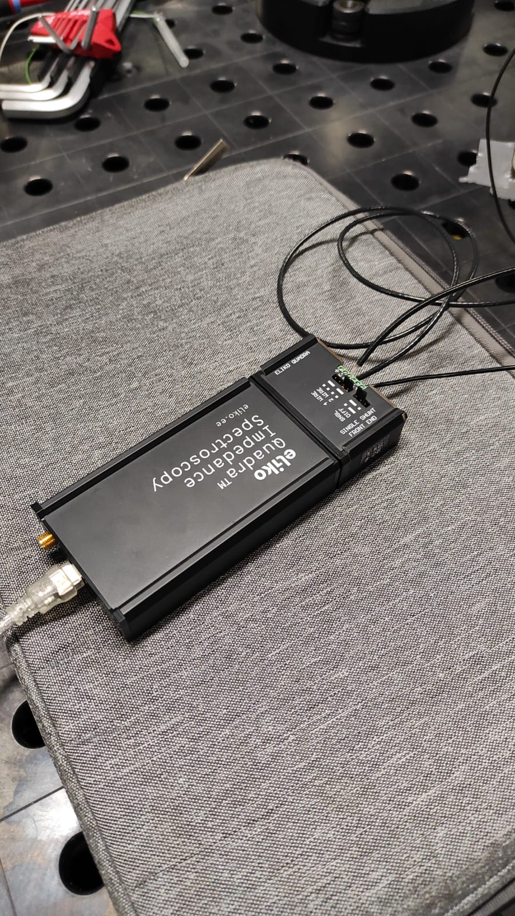
Experiment Set-Up
Equipment & Parameters
6-DOF Robot Arm - Universal Robotics UR3
Eliko QuadraTM Impedance Spectroscopy
Salter water bath
Cylindrical aluminum and plastic objects
Davinchi probes (input current and signal)
Probe is dipped 1mm
10mm between points
Tri-polar configuration

Slide 8
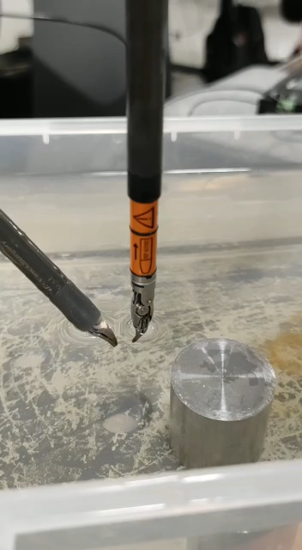
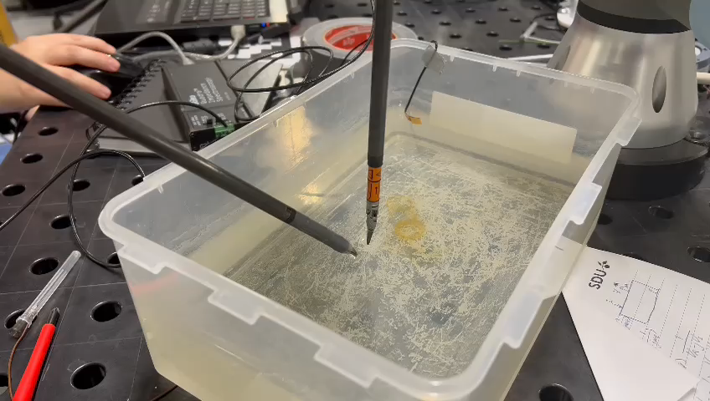
Demo Video

Slide 9
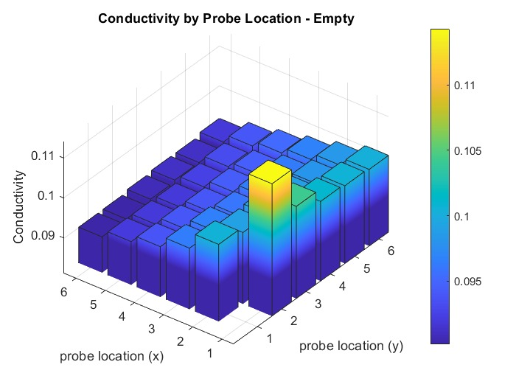
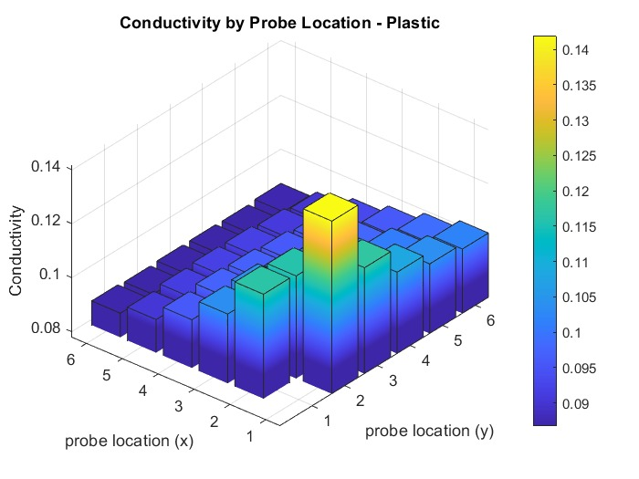
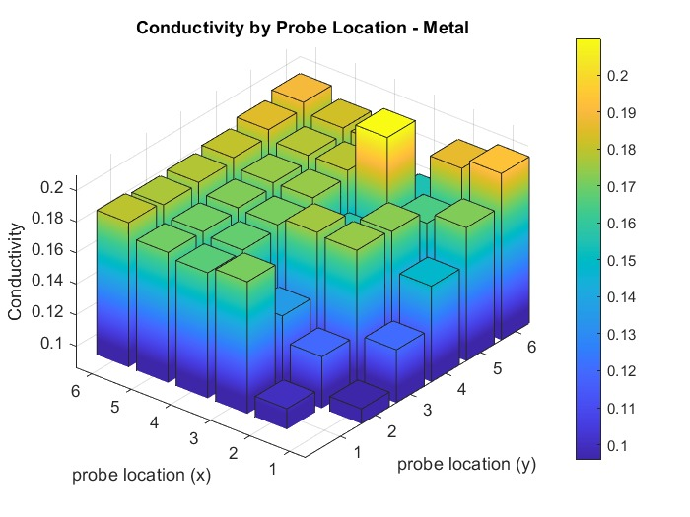
Results
Experiment Targets
Water
Conductivity is constant except when the probe is too close to the charge cloud
Plastic
Conductivity is lower than water but also relatively constant over object surface
Metal
Conductivity is clearly higher over the object
Mannequin Core
Ecoflex 30 Skin (~20mm thick)
Sensor Joint (100kg loadcell)

Slide 10
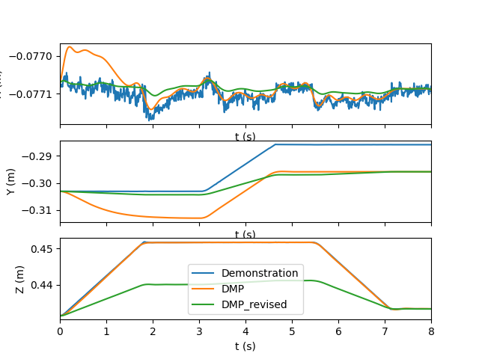
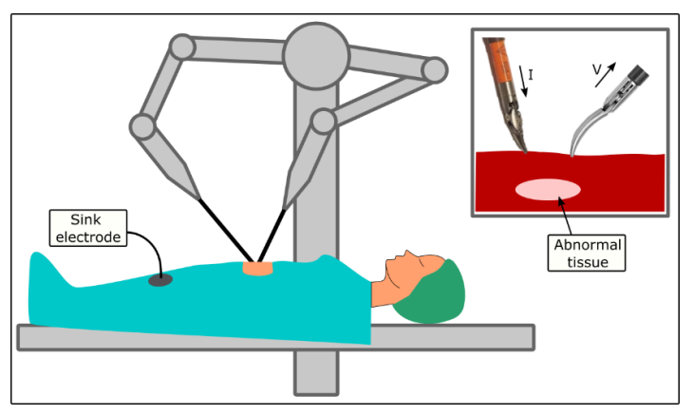
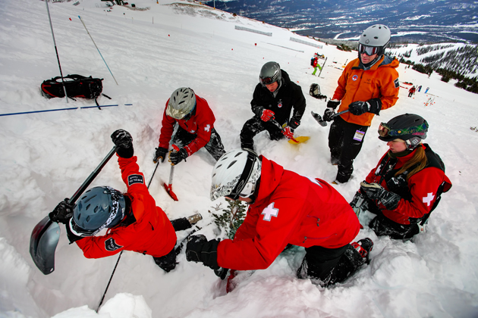
Discussion & Conclusion
Discussion
Conductivity
Results are accurate if:
The probe is too deep in the water
The distance between the target & surface is too far away
DMPs
Overall DMP shape tracks the initial and goal points
Demonstration trajectory is not preserved if:
Distances are different
Orientations are different
Reformulating DMPs to preserve MCK can fix the issue
Possible applications
Avalanche search and rescue
Lochness monster search and destroy
Submarine Espionage

Slide 11
Thank You
고맙습니다

